Slide 1
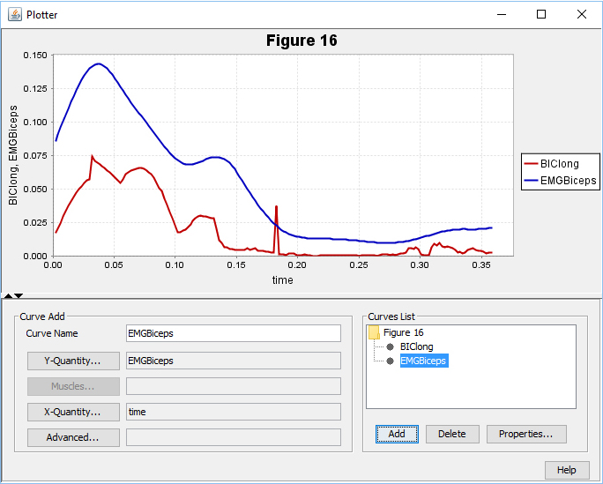
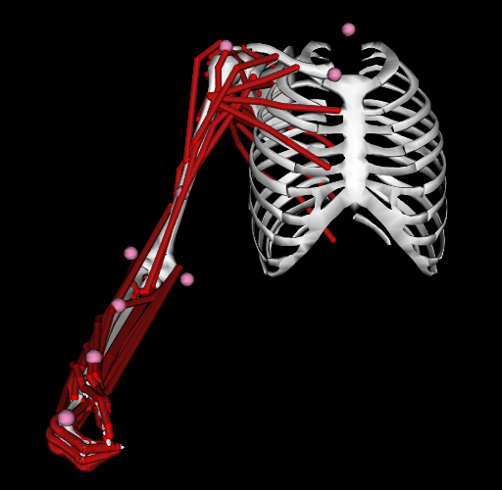
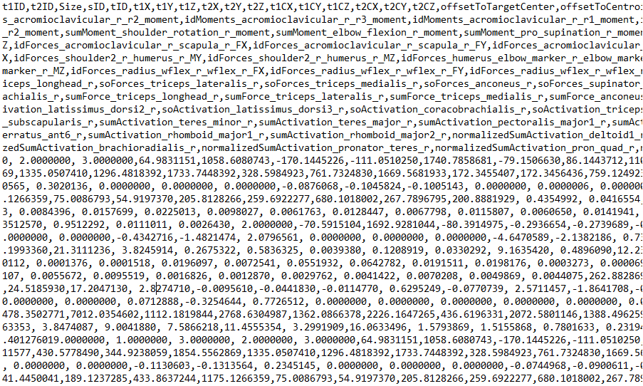
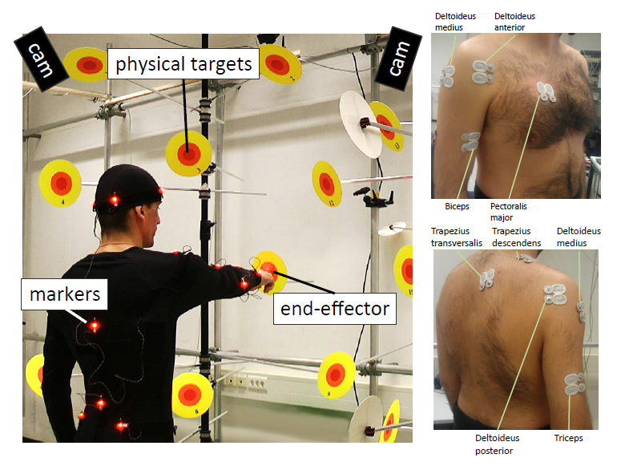
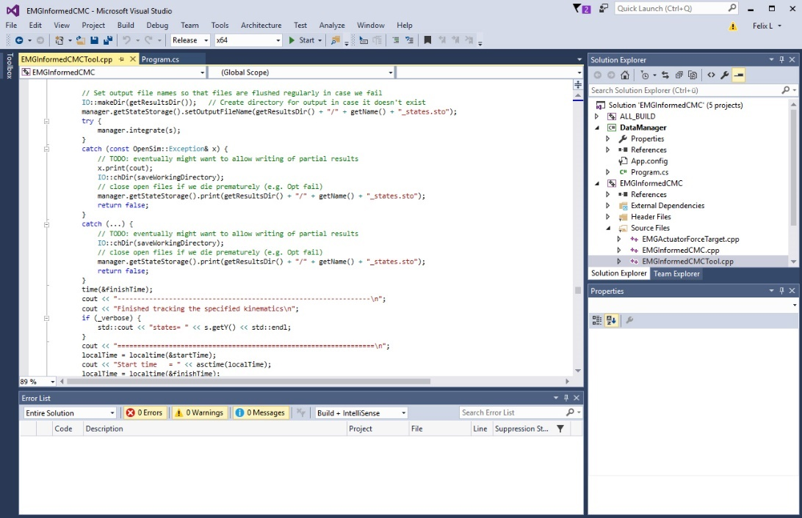
EMG Based Motion Capture [Project] From Motion Capture to Musculoskeletal Simulation and (not quite) back
Felix Laufer

Slide 2
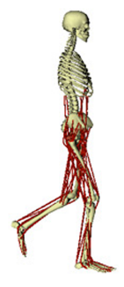
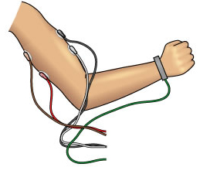


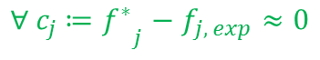



Recap: Why EMG Based Activation Estimation?
$$\sum_{i=1}^{N_{m}}{{{(a}_{i})}^{2} \underset{→}{ } min}$$
s.t.
$${{{∀ c}_{j} ≔f}^{∗}}_{j}−f_{j, exp}≈0$$
muscular redundancy
classical stress minimization approach
$$\sum_{i=1}^{N_{m}}{{{(a}_{i})}^{2} \underset{→}{ } min}$$
What about …
co-contraction
fine motor tasks with higher muscle tension
extreme (fast) movements
(temporal / pathological) muscle fatigue … ?
Seminar: Approach 1
s.t.
$${{{∀ c}_{j} ≔f}^{∗}}_{j}−f_{j, exp}≈0$$
$${{∀ c}_{k} ≔a}_{k}−a_{k, exp}≈0$$
neurophysiological redundancy /
activation patterns
EMG informed minimization approach
?
Project: Is surface EMG data (sEMG) a valid estimator
for computed muscle activation in practice?
$${{∀ c}_{k} ≔a}_{k}−a_{k, exp}≈0$$

Slide 3
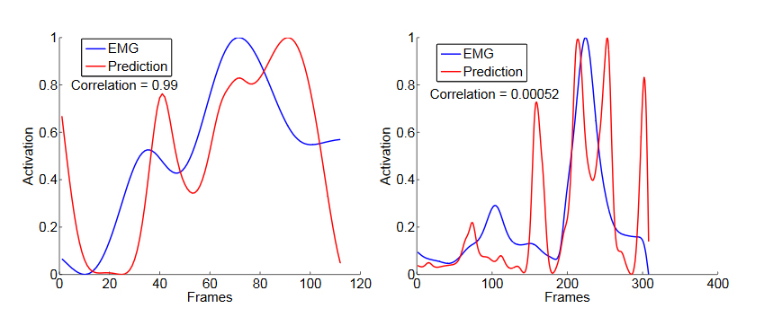
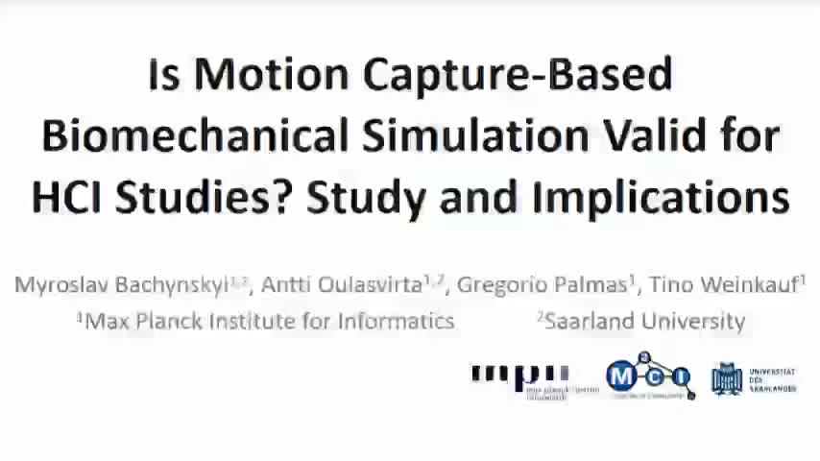
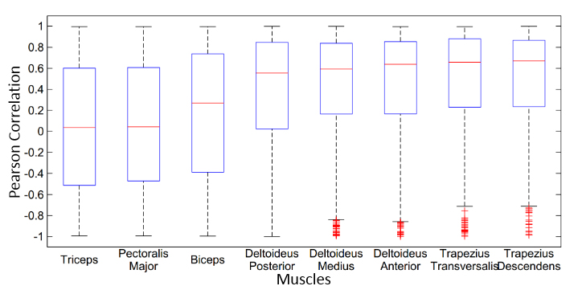
Project Setting & Motivation – MPI Study
sEMG (8 muscles)
MPI study suggests that sEMG is a useful predictor for muscle activation Goal := Verify that, reproduce results!

Slide 4
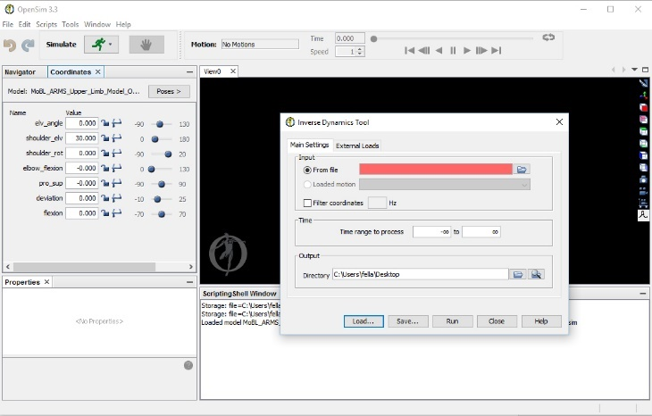


Project Plan – Overview
OpenSim
Arm model (musculosceletal)
+
Inverse Kinematics
Inverse Dynamics
Musculoskeletal Simulation
joint angles
forces, torques
muscle activation and forces
MPI data
Q1?
sEMG measurements
(8 muscles)
pointing movements
(joint kinematics)
computed muscle activations
(classical minimization approach)

Slide 5
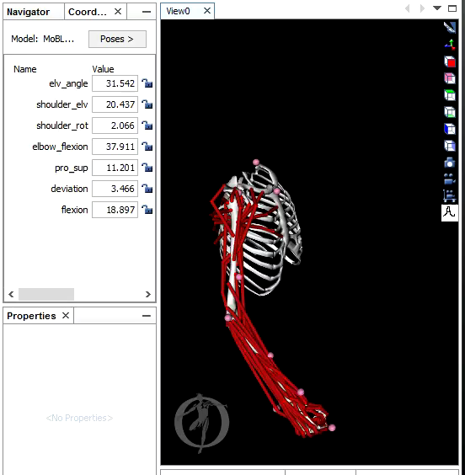
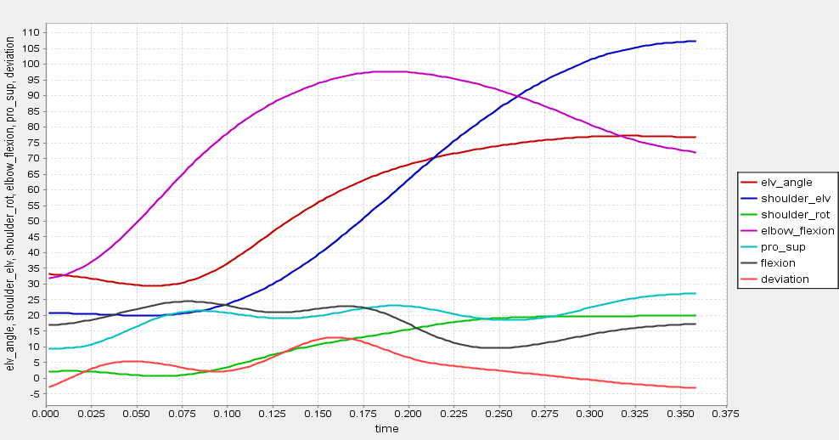
Project Plan – A Look at the Source Data
MPI data
sEMG measurements
(8 muscles)
pointing movements
(joint kinematics)
computed muscle activations
(classical minimization approach)

Slide 6

Actual Project – "Flowchart"
MPI study used commercial
full-body model (SIMM)
Choose open source full-body model
Conflicts with latest OpenSim version
Downgrade to earlier version
Partial arm model has been updated!
New model release requires new data mapping
Different inverse dynamics algorithms
Classical minimization algorithm converges ... but ...
There are only antiquated free
full-body models!
Choose a free partial arm model
Intermediate inverse dynamics results (joint torques) are totally different from study results!
Complex mapping between full-body model data vs. partial arm model requirements ... finally works!
Trial and error phase, change any parameter randomly
Classical minimization algorithm doesn‘t converge!

Slide 7
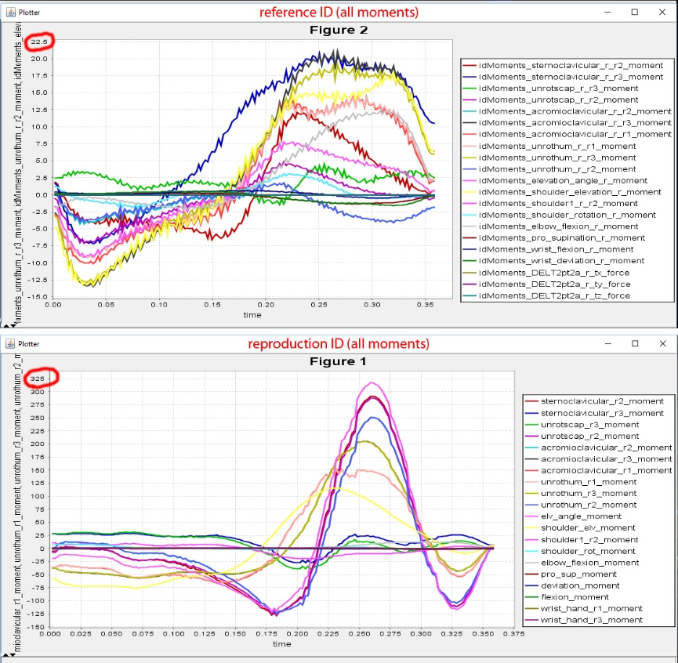
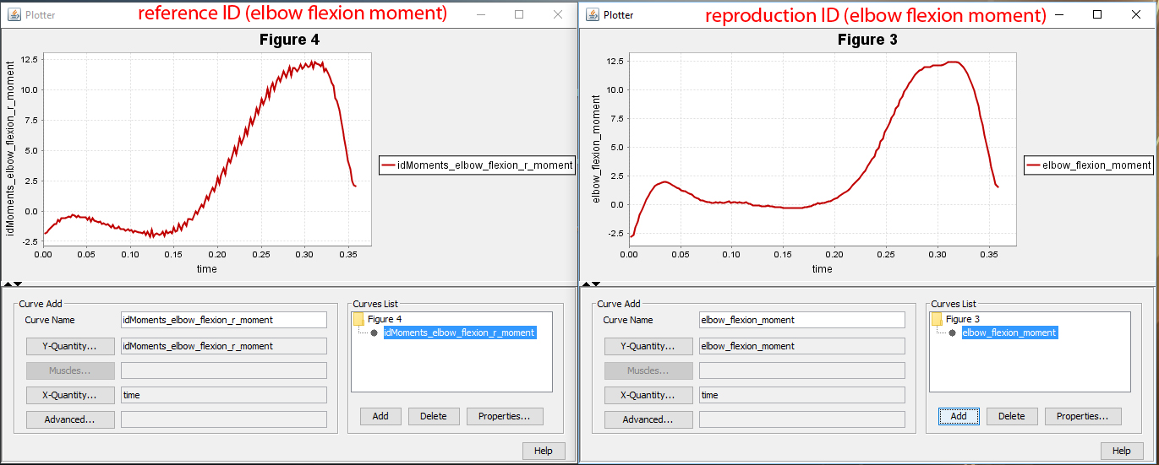
Problem: Inconsistent Dynamics
Inconsistent inverse dynamics solution:
proximal joint torques very different!
But: distal joint torques (e.g. elbow) quite similar!

Slide 8

Main Problem = Different Models
Discussion with ...
Myroslav Bachynskyi Kate Saul (partial OpenSim community
(MPI study) arm model dev.) (simtk.org)
"The proximal joints are much more complicated including lots of phantom joints and coupling to enable motion of the shoulder girdle so it makes total sense to me that if there is a discrepancy it is there, and not at the elbow […]“ (K. Saul)
"Note that forces such as contact, ligaments, bushings, and even muscles will be applied to the model [during inverse dynamics]" (OpenSim Doc.)
"The arm model has restraint torques to mimic ligaments, and the full-body model probably doesn't.“ (K. Saul)
"Inertial properties of the SIMM full-body model might be [systematically] different to the partial arm model." (M. Bachynskyi)
Subject specific scaling of inertial properties is not possible.
(No participant information (mass, scale factors) contained in MPI data)
Inverse Kinematics
Inverse Dynamics
Musculoskeletal Simulation
joint angles
forces, torques
muscle activation and forces
?

Slide 9
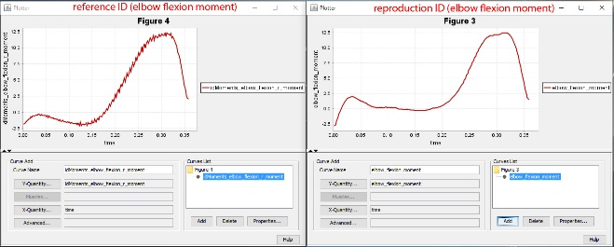
Workaround: Restrained Movements
Alternative plan: Consider only elbow movement, restrain all other joints!
(1 free and 6 fixed DOFs)
➔ Compare only those computed activations vs. sEMG measurements related to elbow joint actuation: biceps, triceps
Since elbow torques are consistent ...
But ...
Restrained kinematics ➔ different dynamics (elbow torque cannot be considered in isolation)
different dynamics ➔ different computed muscle activations (stress minimization approach)
... and ...
elbow actuated by biceps, triceps, brachialis, pronator teres, anconeus, ...
muscular
redundancy!
biceps / triceps actuate elbow, wrist (supination) / shoulder (adduction)
Thus ...
full movement sEMG
measurements
restrained elbow
movement
similar computed muscle activations
valid for ...?
yields ...?
still comparable ...?
How comparable (w.r.t. study) are results under these restraints / assumptions?

Slide 10
(Spurious) Results
biceps correlation: computed vs. sEMG
MPI study: correlations boxplot
r = 0.92, p < 0.01 (N = 170)
Authenticity of correlations "generated" with ...
different model
(inertia, internal forces, muscle properties, ...)
restrained kinematics
But there are also "spurious" correlations contained in the actual study results!
Correlate totally unrelated muscles:
e.g. pronator teres vs. deltoid ➔ r = 0.74
Inverse Kinematics
Inverse Dynamics
Musculoskeletal Simulation
joint angles
forces, torques
muscle activation and forces
!

Slide 11
Project Difficulties and Sources of Error
marker placement & tracking
real vs. virtual markers
tracking accuracy
repeatability
inverse kinematics
drift of markers
joint modelling
numerical errors
inverse dynamics
measure of external forces
distribution of body mass
numerical errors
Motion Capture
Inverse Kinematics
Inverse Dynamics
Musculoskeletal Simulation
marker trajectories
joint angles
forces, torques
muscle activation and forces
generalizability (subject ⬄ model)
individual neural drive and activation strategies
MTU params highly dependent on subject
model scaling
marker points
distribution of body mass
…
(neuro)muscular redundancy
muscular := several muscles for one joint or muscles spanning multiple joints
neurophysiological := task-dependent activation strategies or multiple neurons innverating the same muscle
co-contraction
MTU modelling
tendon slack length,
optimal fiber length
and maximum isometric force
…
EMG ⬄ muscle activation⬄ muscle forces
mapping poorly understood,
no reliable models
Motion Simulation
Forward Kinematics
Forward Dynamics
Musculoskeletal Modelling
marker trajectories
joint angles
forces, torques
muscle activation and forces
EMG extraction and processing
surface EMG only (no deeper MTUs)
characterizing frequency bandwidths
➔ generalizability?

Slide 12
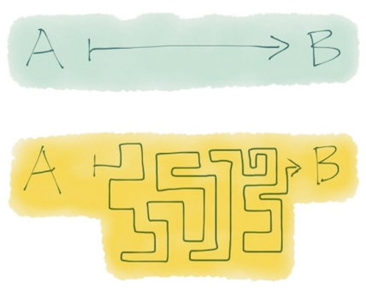
Thanks for your attention! From Motion Capture to Musculoskeletal Simulation and (not quite) back
Theory
Seminar
vs.
vs.
Practice
Project
Questions?

Slide 13
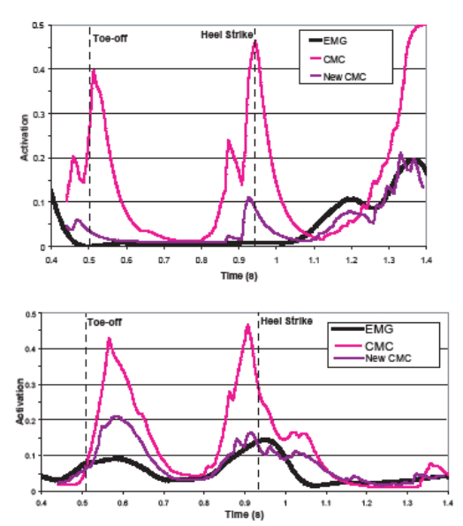



Assuming that sEMG is a valid estimator ...
$$\sum_{i=1}^{N_{m}}{{{(a}_{i})}^{2}}+\sum_{j=1}^{N_{c_{j}}}{ω_{j}{{{(f}^{∗}}_{j}−f_{j, exp})}^{2}+\sum_{k=1}^{N_{c_{k}}}{ω_{k}{(a_{k}−a_{k, emg})}^{2} }}\underset{→}{ } min$$
$$\sum_{k=1}^{N_{c_{k}}}{ω_{k} Corr\left(a_{k},a_{k, emg}\right) \underset{→}{ } max}$$
$$\sum_{i=1}^{N_{m}}{{{(a}_{i})}^{2}}+\sum_{j=1}^{N_{c_{j}}}{ω_{j}{{{(f}^{∗}}_{j}−f_{j, exp})}^{2}−}\sum_{k=1}^{N_{c_{k}}}{ω_{k} Corr\left(a_{k},a_{k, emg}\right) }\underset{→}{ } min$$

